Slide 1
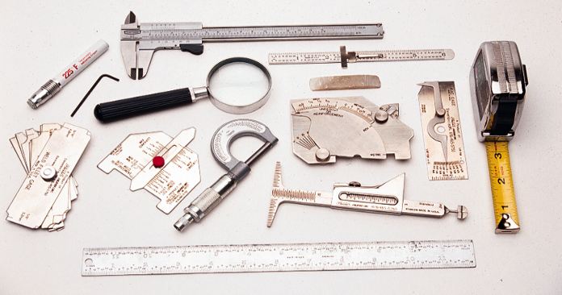

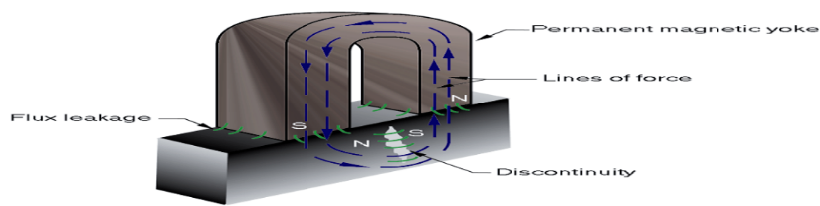

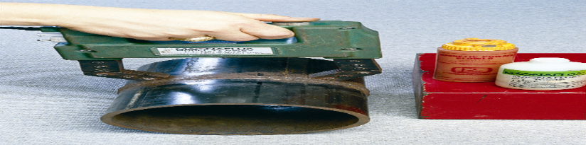
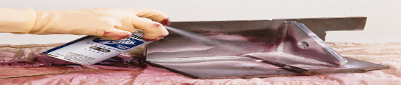
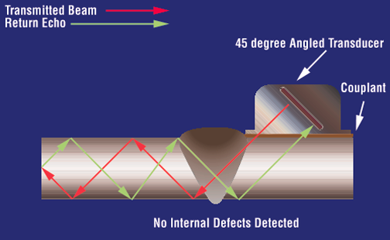
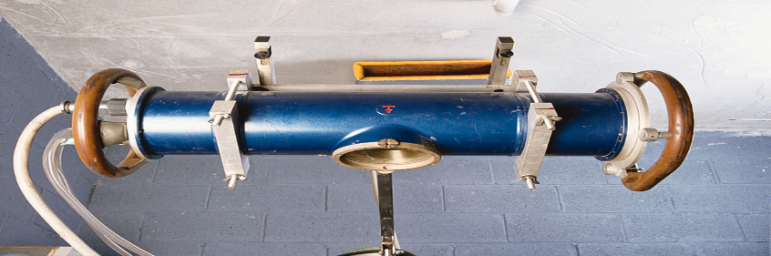
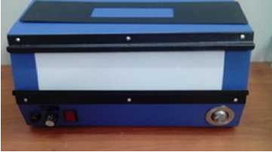
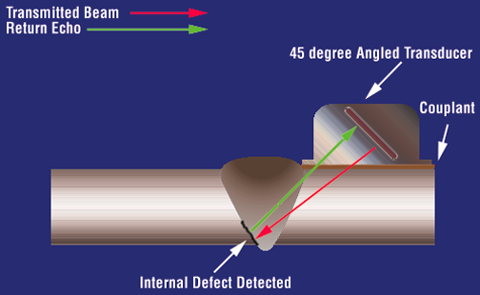
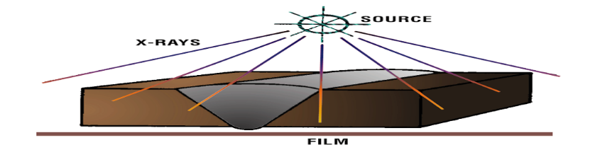
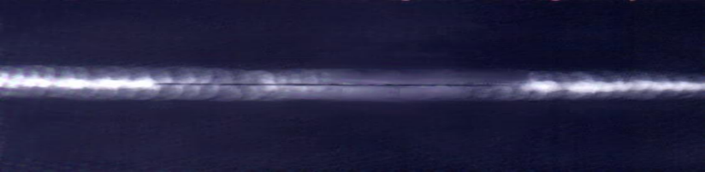
MECTEK IND SOURCING NDT DIVISION
VISUAL TESTING
DYE PENETRANT TESTING
MAGNETIC PARTICLE TESTING
ULTRASONIC TESTING
RADIOGRAPHY TESTING
RADIOGRAPHIC INTERPRETATION (RTFI)
FURTHER DETAILS CONTACT
NO 29/A Ground floor, Anna St, Srinivasa Nagar Padi Chennai -600 050
Contact No 94444 61538/8667554033/8925023444
E-Mail id: gammaraymsv@gmail.com / jag.mechotech@yahoo.com

