Slide 1
MECTEK IND SOURCING
NDT DIVISION
NO 29/A Ground floor, Anna St, Srinivasa Nagar Padi Chennai -600 050
Contact No 94444 61538/8667554033/8925023444
E-Mail id: gammaraymsv@gmail.com jag.mechotech@yahoo.com
WE PROVIDE NDT SERVICES
AND
TRAINING - CERTIFICATION

Slide 2
SERVICE OFFERED BY US
VISUAL TESING (VT)
DYE PENETRANT TESTING (DPT)
MAGNETIC PARTICLE TESTING (MPT)
ULTRASONIC TESTING (UT)
RADIOGRAPHY TESTING (RT)
RADIOGRAPHIC INTERPRETATION (RTFI)

Slide 3
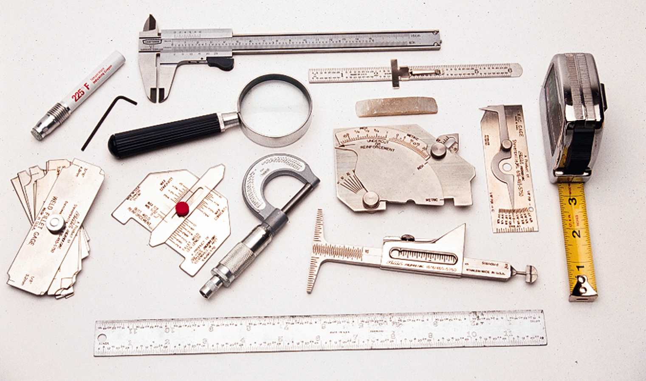
VISUAL TESTING
VISUAL INSPECTION TOOLS

Slide 4
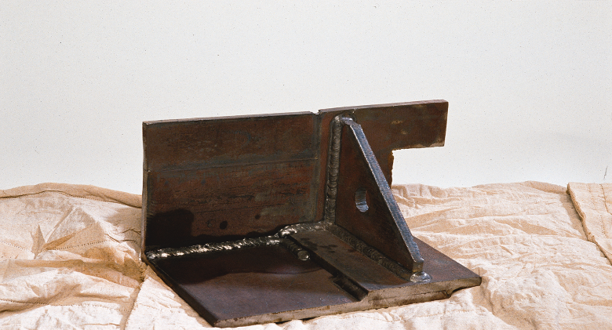

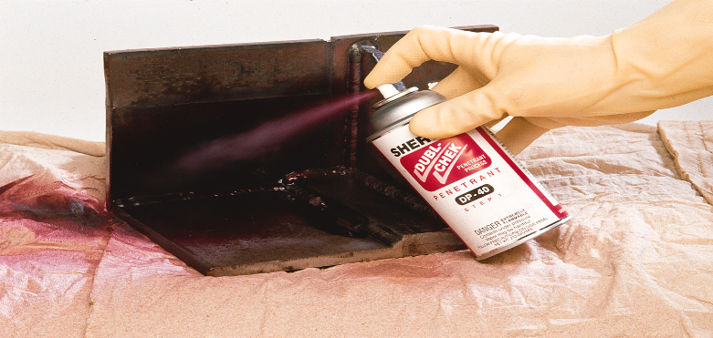
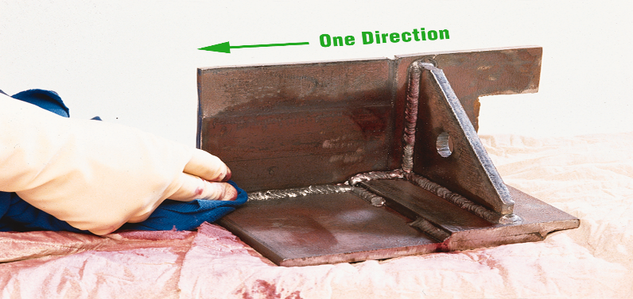
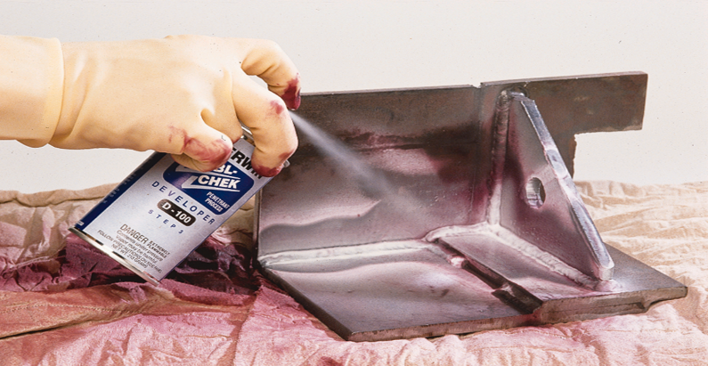
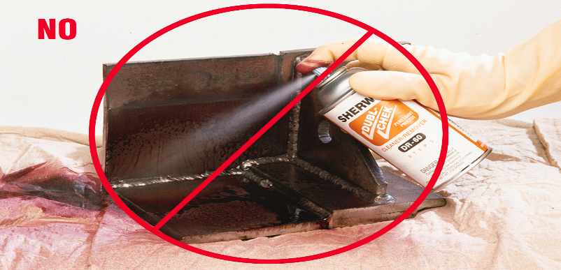
DYE PENETRANT TESTING (DPT)
PRE-CLEANING
USE LINT FREE CLOTH TO CLEAN
APPLY PENETRANT (SPRAY)
CLEAN THE SPECIMEN
APPLY DEVELOPER (SPRAY)
SPARY THE CLEANER DIRECT

Slide 5
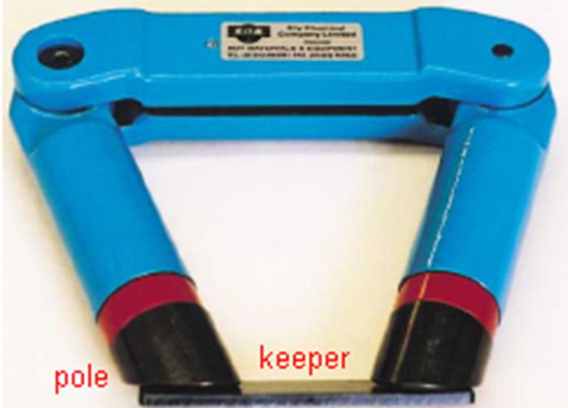
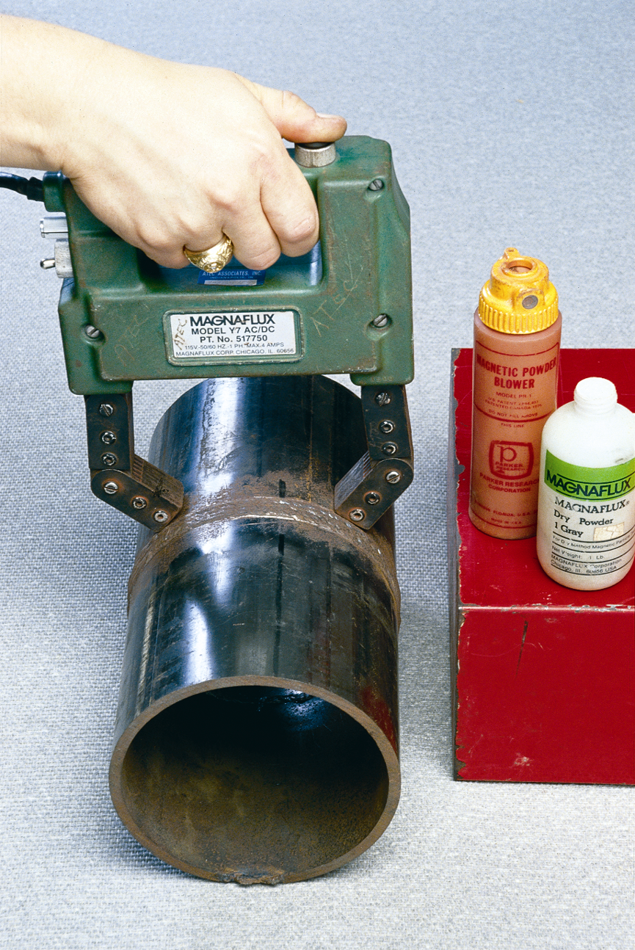
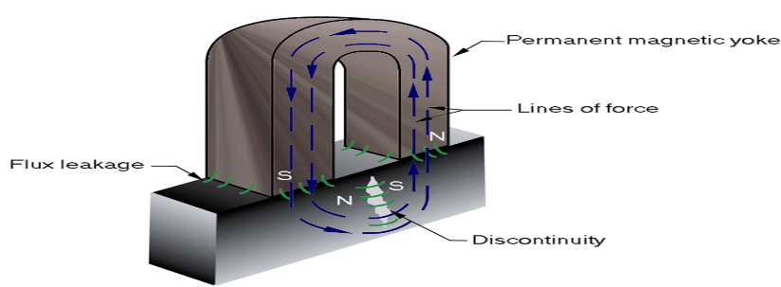
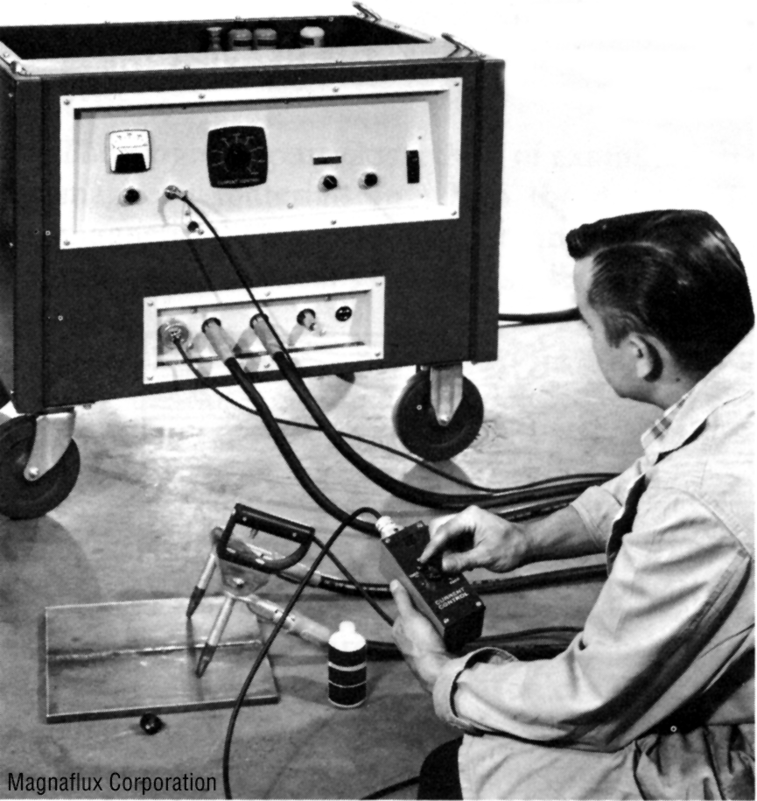
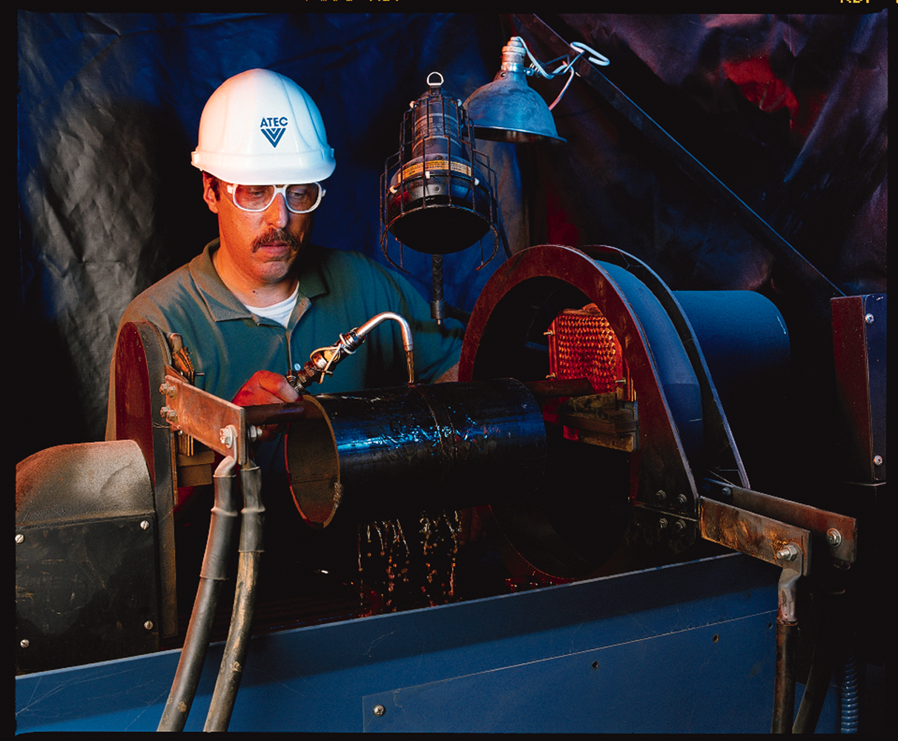
MAGNETIC PARTICLE TESTING (MPT)
ELECTRO MAGNETIC YOKE
PERMANENT MAGNET
BENCH EQUIPMENT CC METHOD
PROD EQUIPMENT

Slide 6
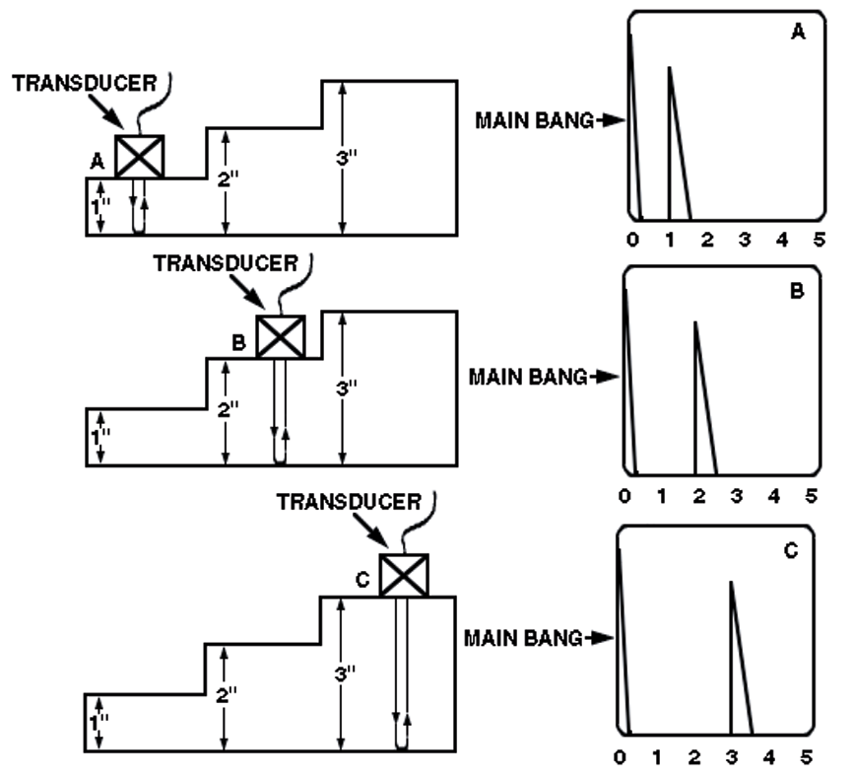
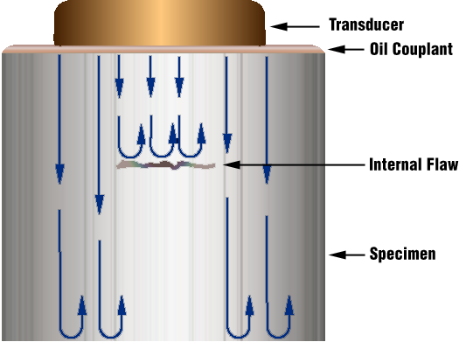
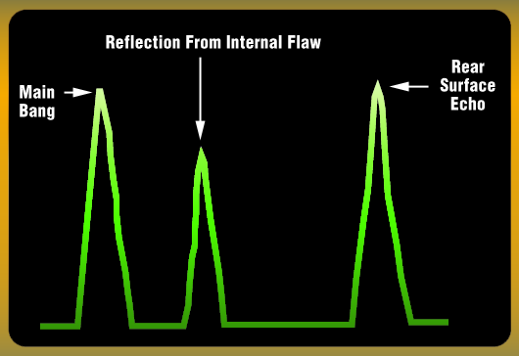
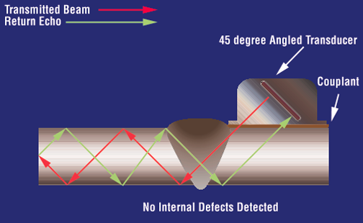
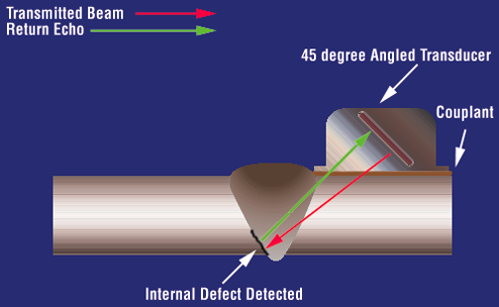
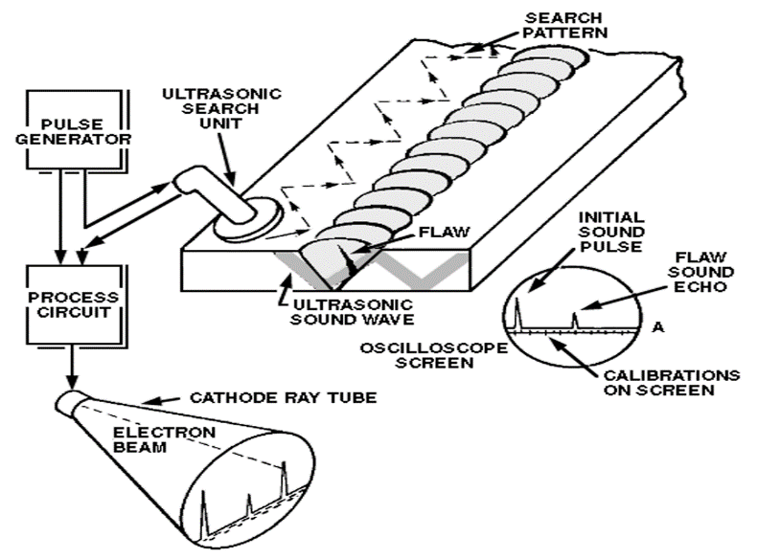
ULTRASONIC TESTING (UT)
NORMAL PROBE RANGE SETTING
NO DEFECT
DEFECT DETECTED
WELD SCAN (ANGLE PROBE)

Slide 7
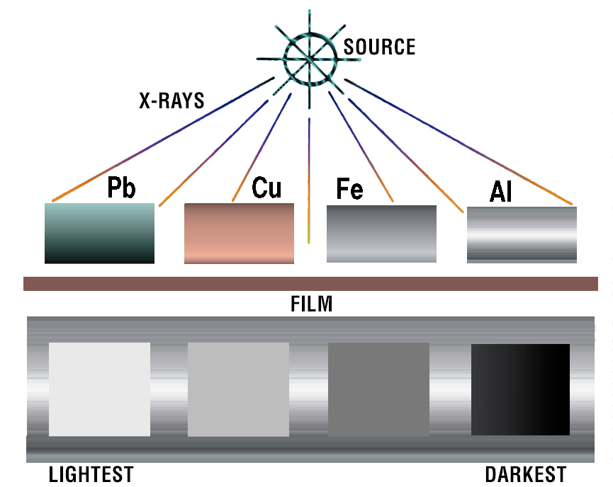
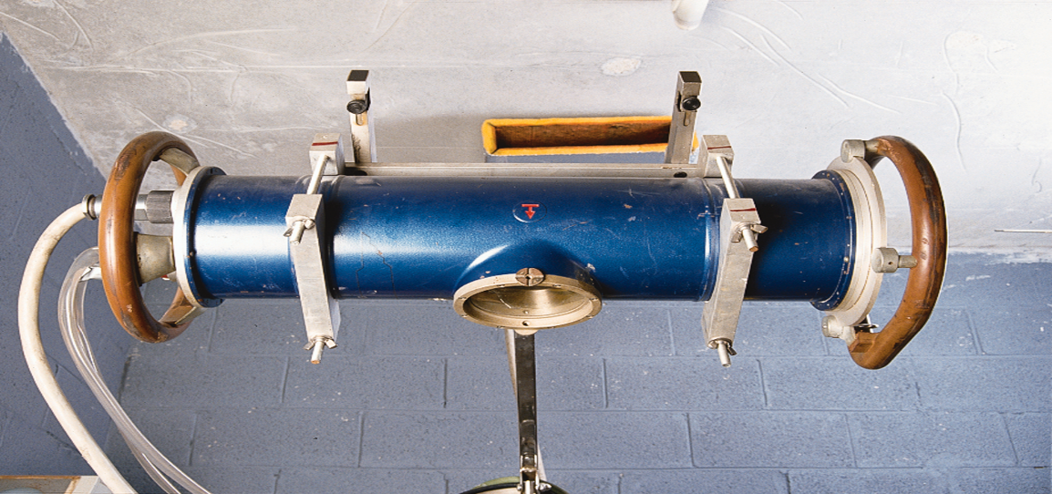
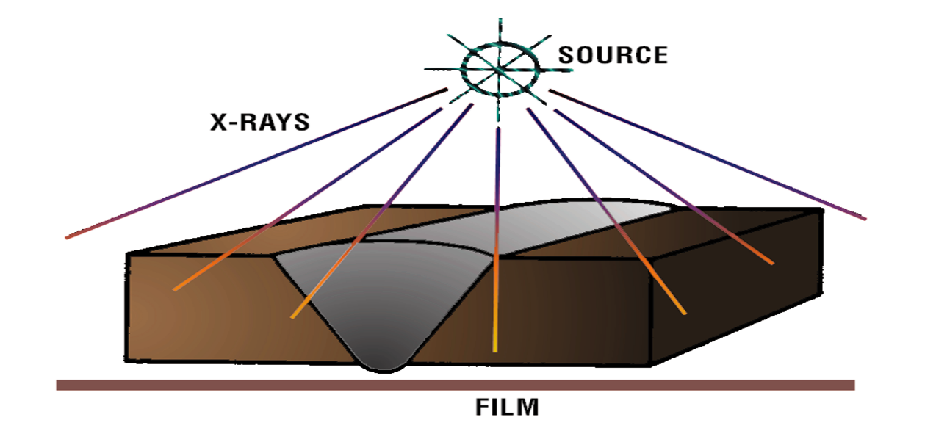
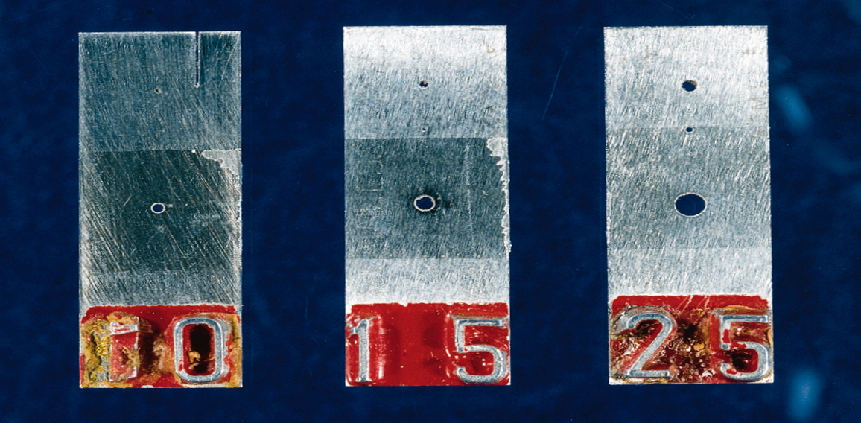
RADIOGRAPHY TESTING (RT)
Different Material Different Density
X-ray Machine arrangement
Single Wall Single image Technique
Image Quality Indicator (Plate)

Slide 8
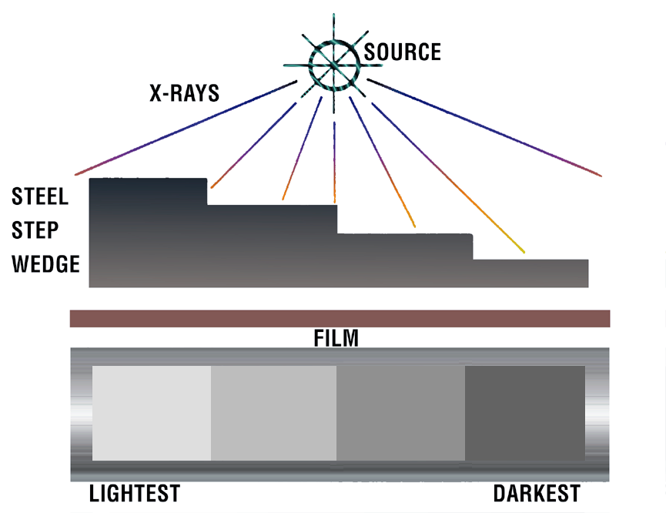
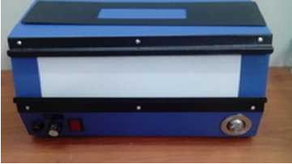
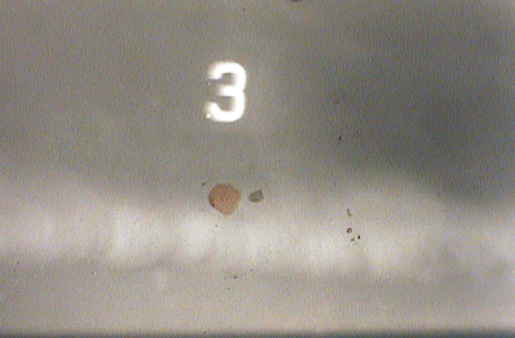

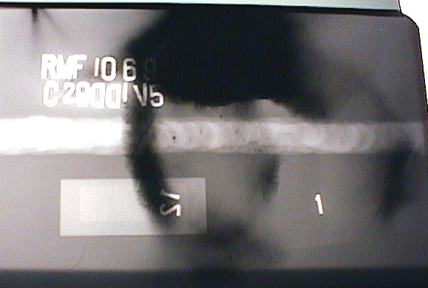
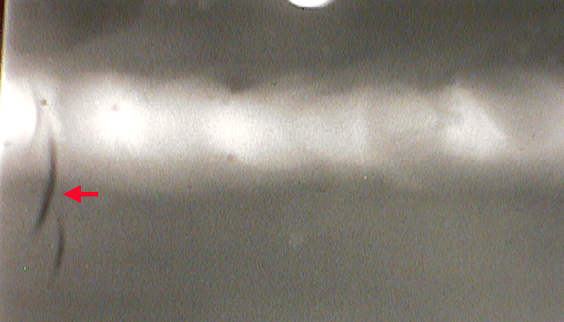
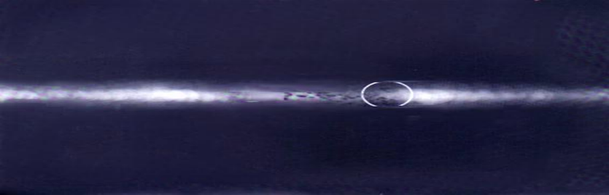
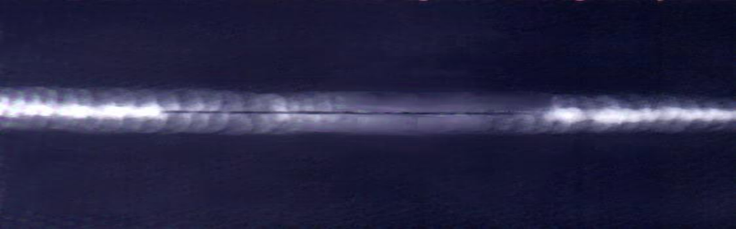
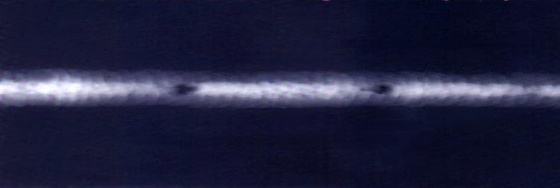
RADIOGRAPHIC INTERPRETATION (RTFI)
Density on IQI | +30% | -15%
2.0 | 2.6 | 1.7
2.5 | 3.25 | 2.1
STEP WEDGE
DENSITY RANGE
VIEWER
WATER MARK
CHEMICAL MARK
FOLD MARK
FILM FOG
LACK OF PENETRATION
ROOT CAVITY
G.PORES

Slide 9
ABOUT US
Gammaray Services was established in 2005 at Saidapet, Chennai – 15, and has been in the field since then. We provide services to various industries, including petrochemicals, power plants, sugar industries, and pressure vessels.
Details of the service are listed below
SERVICES PROVIDED BY US
1. Radiography Testing.
2. Ultrasonic Flaw Detection / Thickness measurement. (UFD & UTG)
3. Magnetic Particle Testing.
4. Dye Penetrant Testing.
5. Training and Consultancy

Slide 10
Now, Gammaray Services merged with Mectek Ind Sourcing
Mectek Ind Sourcing NDT division is headed by Shri. M.S. Viswanathan, who has had wide knowledge in NDT for the past 48 years. He served in prestigious organizations such as BHEL/NTPC/EIL/AUDCO/TPL, and conducted third-party inspections for Lloyd's, DNV, BVQ, IRS, etc. Conversant with international codes and specifications like ASME, ANSI, DIN,BS, and BIS.
Apart from him, we have an associate with ASNT LEVEL III for our Technical consultancy.

Slide 11
LIST OF EQUIPMENTS
1. Ultrasonic Flaw Detector _ 1 No
Modsonic (Digital) Einstein II Sl. No 1762-0908
2. Probe Normal Modsonic 2 Nos
3. Probe Dual Modsonic 2 Nos
4. Probe Angle Modsonic 2 Nos
5. Cable Limo to Mini limo 6 Nos
6. Reference block V1 1 No
7. Reference Block V2 2 Nos
8. Magnetic Yoke 1 No
9. ASTM Ref Block for MPI 1 No
10. PIE Gauge 2 Nos
For Penetrant testing, we use a reputed brand chemical like Magnaflux,
MR chemicals, etc.

